Slide 1

Overview of selected topics in computational catalysis that are helpful
Neeraj Rai
^{neerajrai@che.msstate.edu}
Dave C. Swalm School of Chemical Engineering and Center for Advanced Vehicular Systems, Mississippi State University, USA
DFT for Catalysis Summer School, June 13-18, 2022

Slide 2
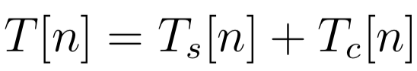
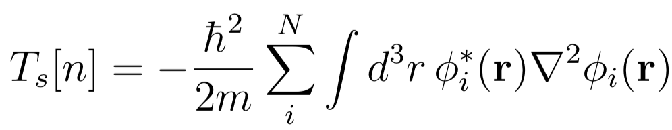
Exchange-correlation functional
Write down total kinetic energy functional as the sum of non-interacting particle density (n) and the one that represents rest of the kinetic energy functional
where,
We rewrite the exact energy functional as:
Capelle, Brazilian Journal of Physics, 36, 1318-1343, 2006
neerajrai@che.msstate.edu

Slide 3
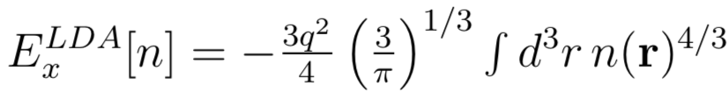
Local density approximation (LDA)
Exchange Functional (based on the exact exchange energy of homogeneous electron system):
The correlation functionals are parameterized against quantum Monte Carlo results for uniform electron gas. The overall exchange-correlation functional is of the form:
Success of LDA is primarily due to the cancellation of errors (E_{X} is overestimated while the E_{C} is underestimated]
Capelle, Brazilian Journal of Physics, 36, 1318-1343, 2006
neerajrai@che.msstate.edu

Slide 4
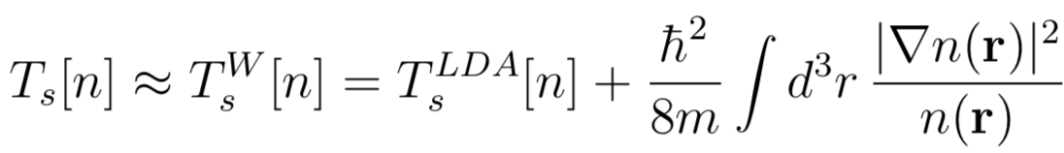
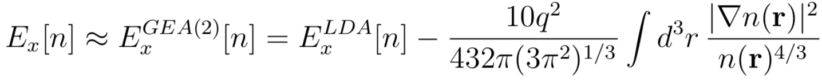
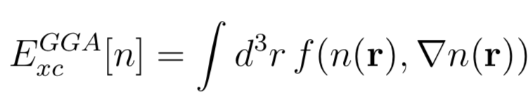
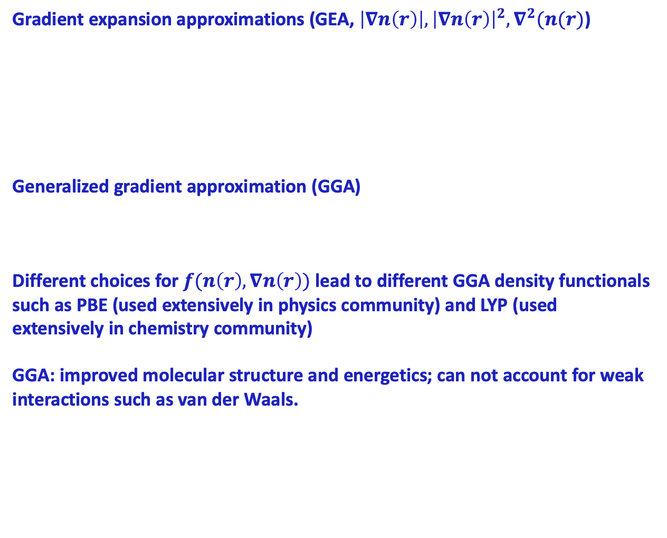
Semilocal functionals
Gradient expansion approximations (GEA, $\left|∇n\left(r\right)\right|,{\left|∇n\left(r\right)\right|}^{2},∇^{2}(n(r)$)
Generalized gradient approximation (GGA)
Different choices for $f(n\left(r\right),∇n\left(r\right))$ lead to different GGA density functionals such as PBE (used extensively in physics community) and LYP (used extensively in chemistry community)
GGA: improved molecular structure and energetics; can not account for weak interactions such as van der Waals.
Capelle, Brazilian Journal of Physics, 36, 1318-1343, 2006
neerajrai@che.msstate.edu

Slide 5
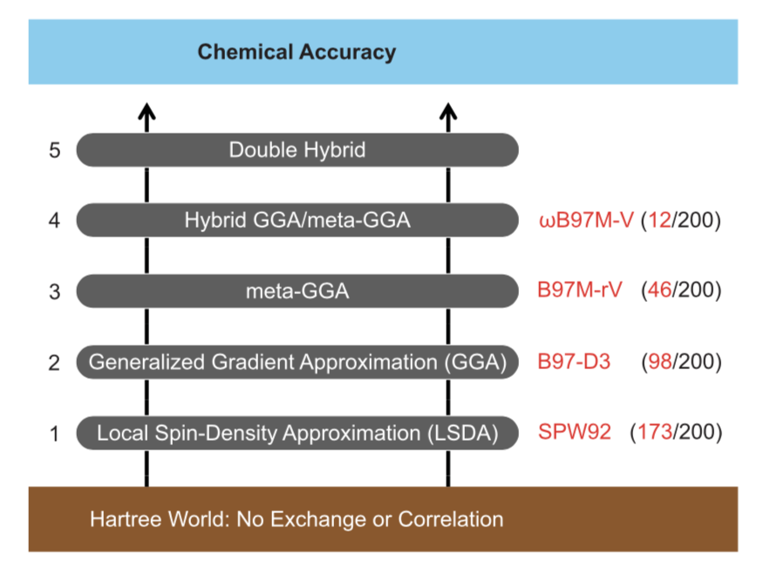
Perdew’s Jacob’s ladder
Mardirossian and Head-Gordon, Mol. Phys., 115, 2315-2372, 2017
neerajrai@che.msstate.edu

Slide 6
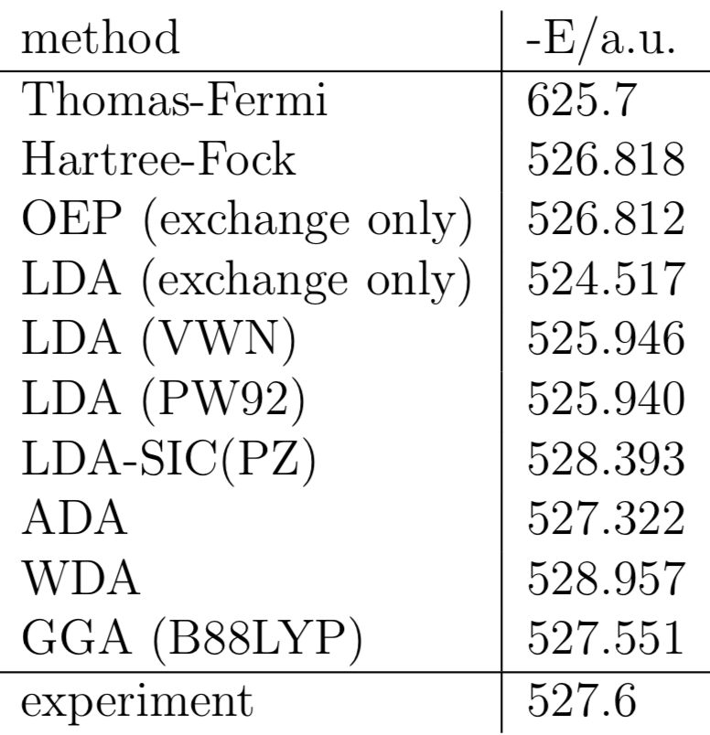
Comparison of different LDA and GGA functions
Ground state energy of the argon atom in atomic units (Hartree)
Capelle, Brazilian Journal of Physics, 36, 1318-1343, 2006
neerajrai@che.msstate.edu

Slide 7
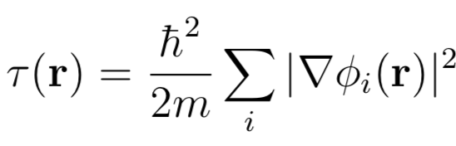
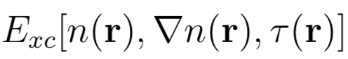
Meta-GGA functionals
Exchange-correlation functional depends not only on the density, gradient of the density but also on the Kohn-Sham kinetic energy density
The additional degree of freedom is used to satisfy:
self-interaction corrected correlation functional
recovery of fourth order gradient expansion for the exchange
finite exchange potential at the nucleus
Capelle, Brazilian Journal of Physics, 36, 1318-1343, 2006
neerajrai@che.msstate.edu

Slide 8
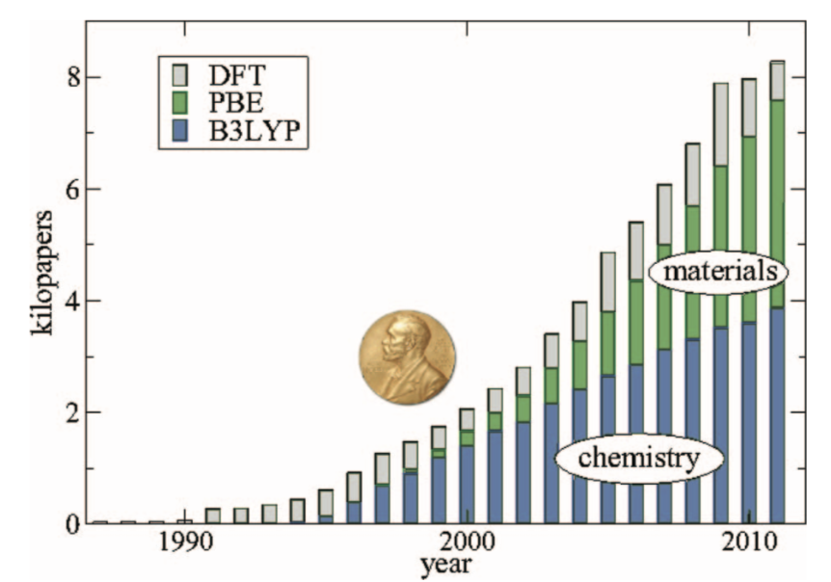
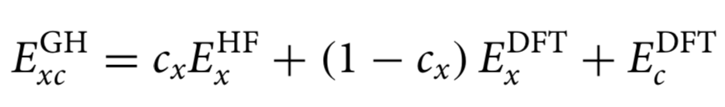
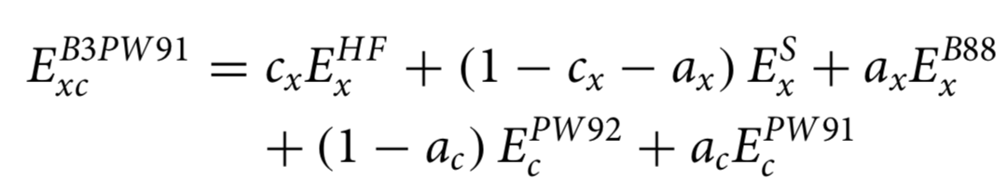
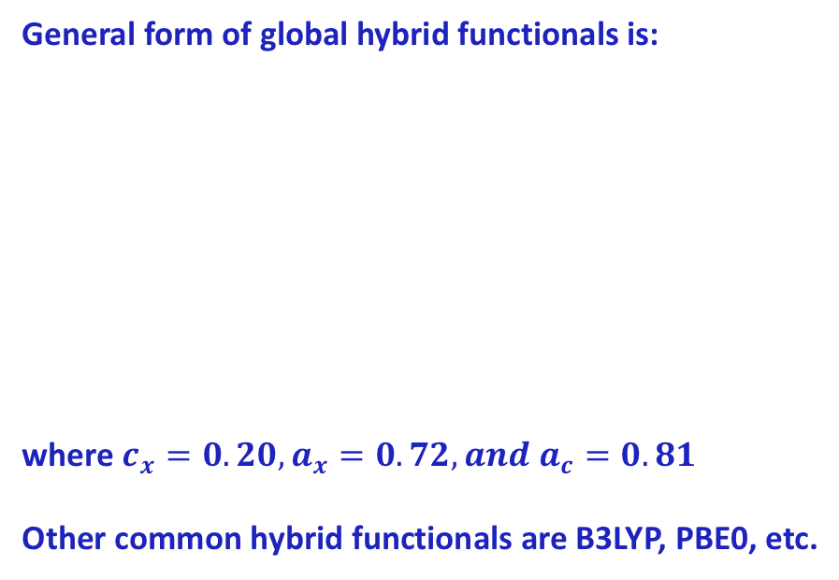
Hybrid GGA, meta GGA
General form of global hybrid functionals is:
where $c_{x}=0.20,a_{x}=0.72,and a_{c}=0.81$
Other common hybrid functionals are B3LYP, PBE0, etc.
B3LYP
Burke, J. Chem. Phys., 136, 150901, 2018
Mardirossian and Head-Gordon, Mol. Phys., 115, 2315-2372, 2017
neerajrai@che.msstate.edu

Slide 9
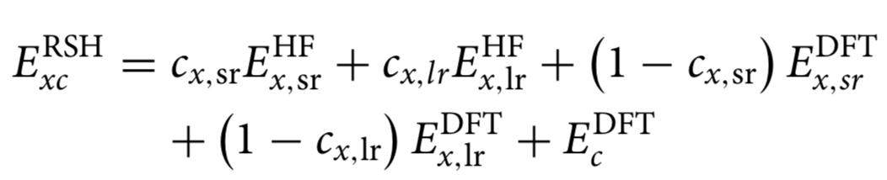
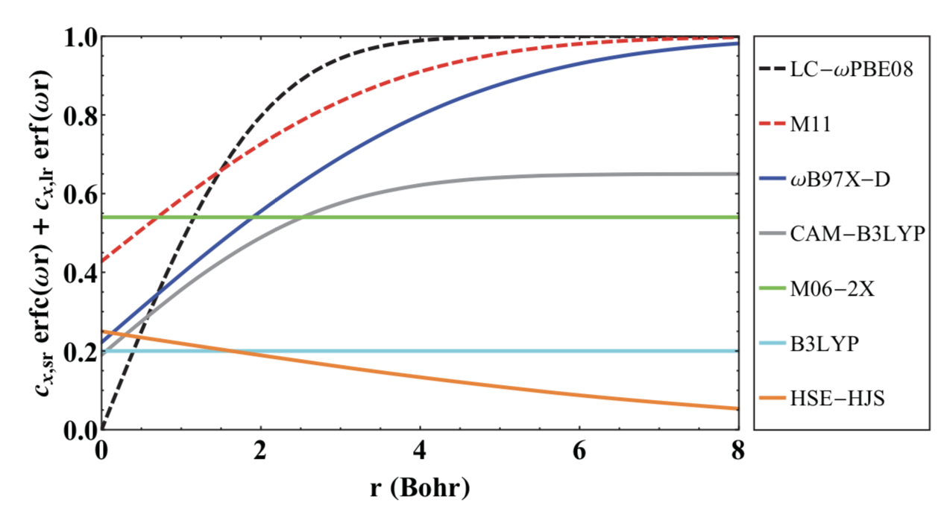
Range separated functionals
Range separated functionals attempt to address self-interaction error and are given by the following form:
Common examples include: ωB97, ωB97X, LRC-ωPBE, etc.
Mardirossian and Head-Gordon, Mol. Phys., 115, 2315-2372, 2017
neerajrai@che.msstate.edu

Slide 10
Another short coming of DFT functionals is the inability to capture vdW interactions
Grimme, Comput. Mol. Sci., 1, 211-228, 2011
neerajrai@che.msstate.edu

Slide 11
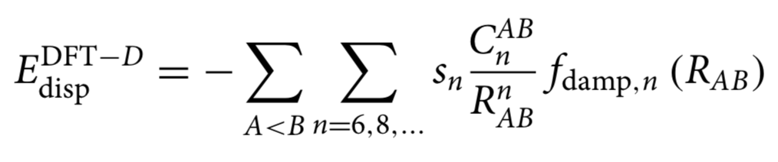
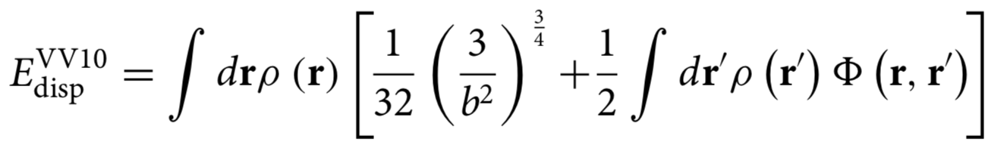
Dispersion-corrected/nonlocal density functionals
Grimme’s dispersion correction model:
Nonlocal density functionals
Mardirossian and Head-Gordon, Mol. Phys., 115, 2315-2372, 2017
neerajrai@che.msstate.edu

Slide 12
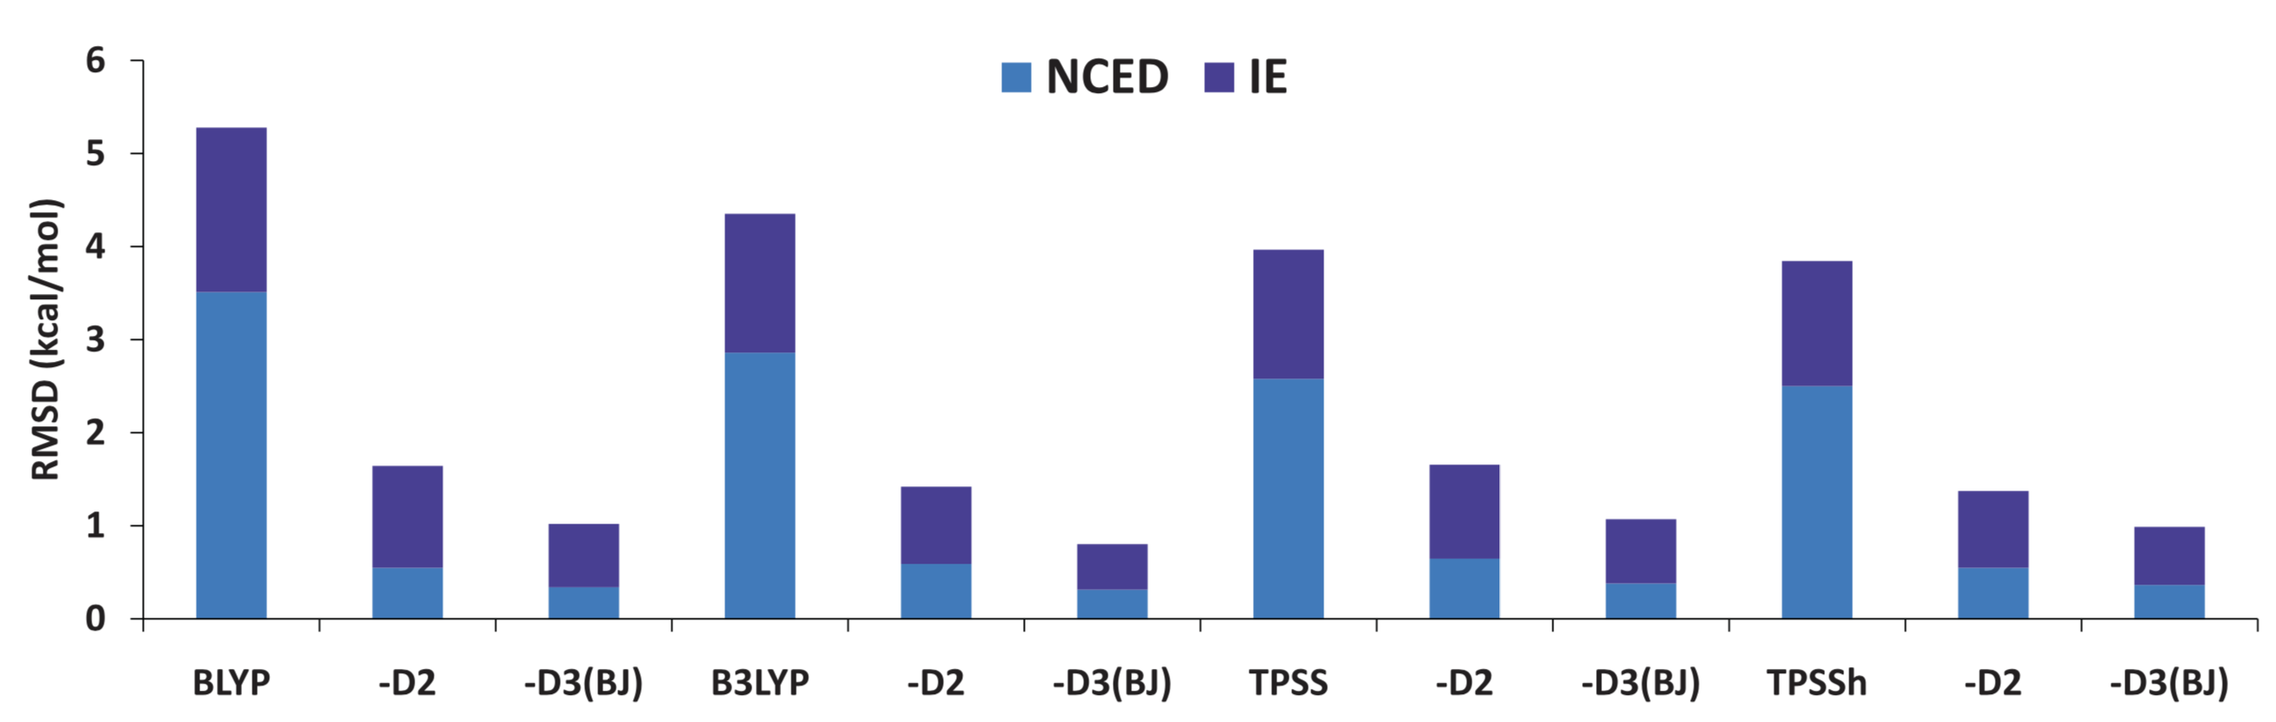
Accuracy of different dispersion correction models
Mardirossian and Head-Gordon, Mol. Phys., 115, 2315-2372, 2017
neerajrai@che.msstate.edu

Slide 13
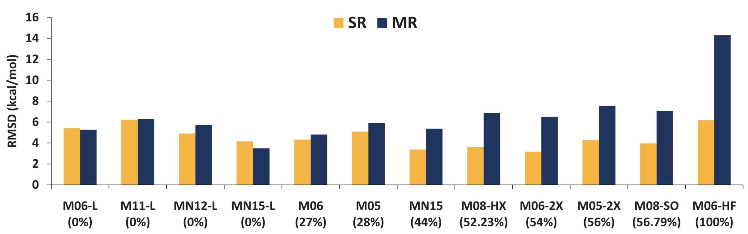
General accuracy for selected MN functionals for atomization energies bond dissociation
Mardirossian and Head-Gordon, Mol. Phys., 115, 2315-2372, 2017
neerajrai@che.msstate.edu

Slide 14
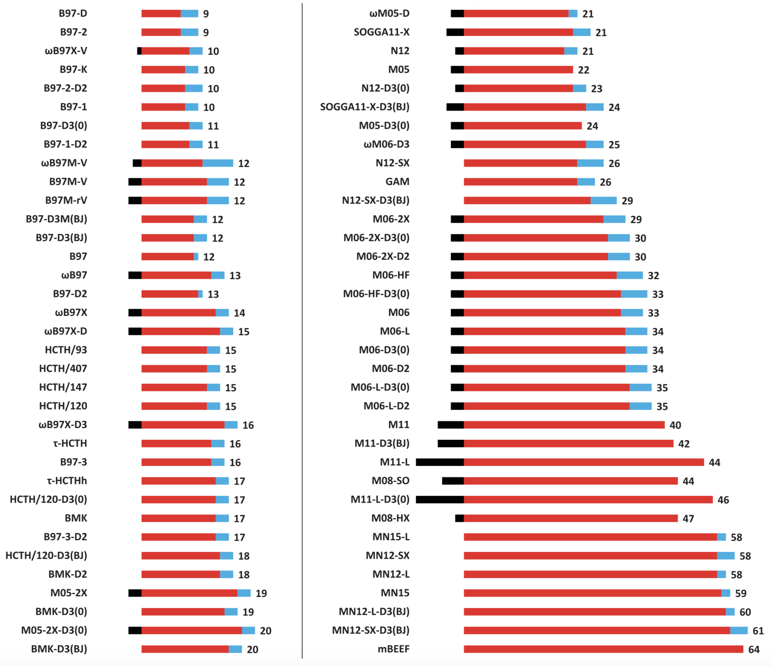
Number of parameters in different density functionals
Mardirossian and Head-Gordon, Mol. Phys., 115, 2315-2372, 2017
neerajrai@che.msstate.edu

Slide 15
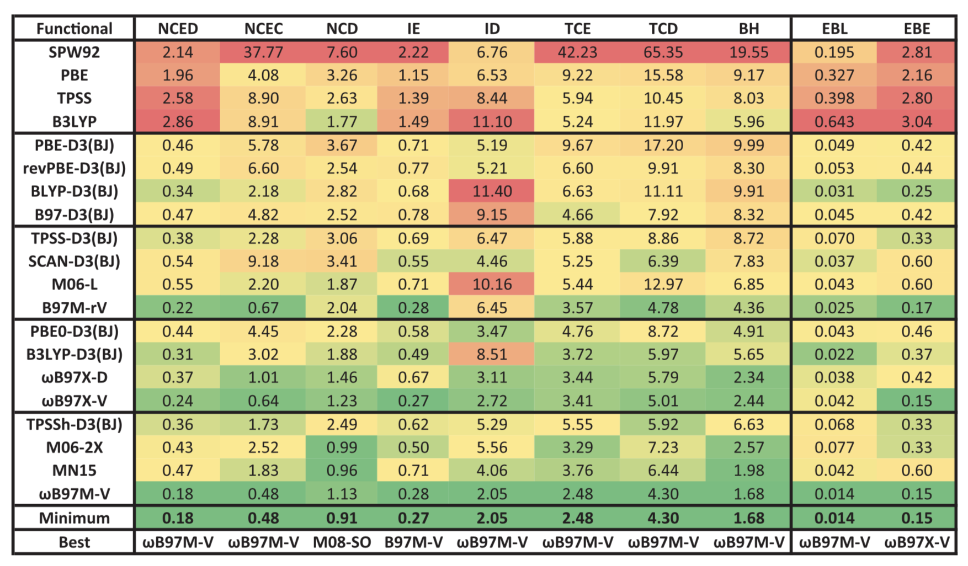
Accuracy of functionals for bond lengths and binding energies
Mardirossian and Head-Gordon, Mol. Phys., 115, 2315-2372, 2017
neerajrai@che.msstate.edu

Slide 16
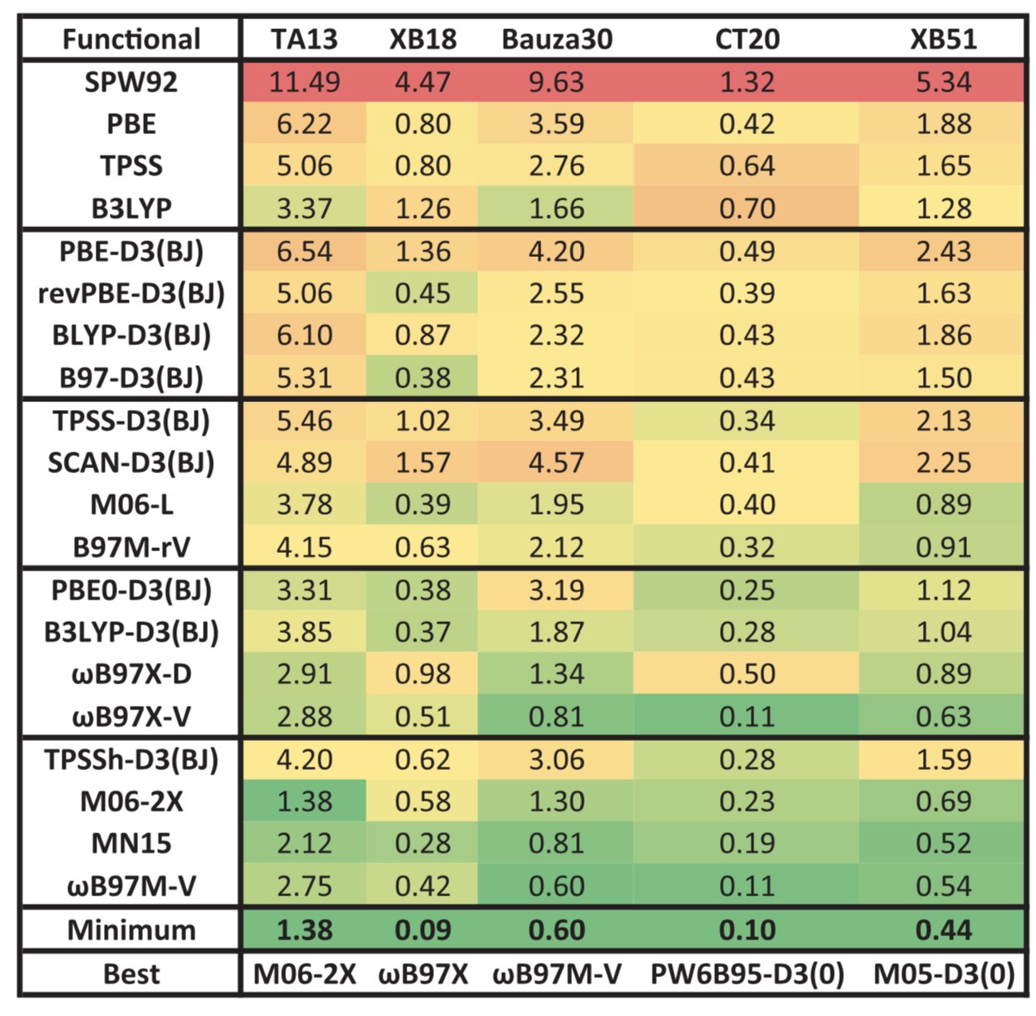
Open-shell non-covalent or dimers characterized by significant electron delocalization
Mardirossian and Head-Gordon, Mol. Phys., 115, 2315-2372, 2017
neerajrai@che.msstate.edu

Slide 17
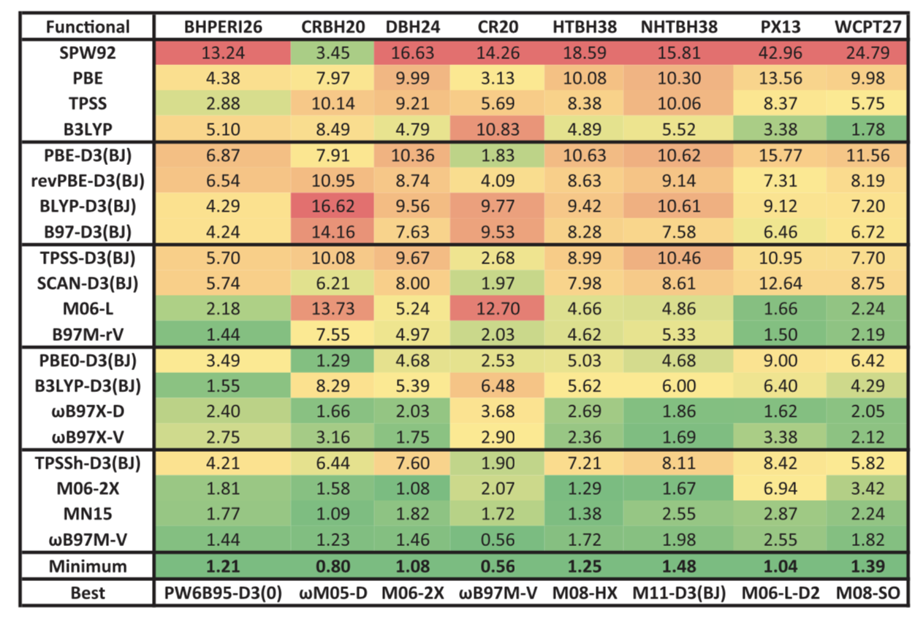
Barrier heights
Mardirossian and Head-Gordon, Mol. Phys., 115, 2315-2372, 2017
neerajrai@che.msstate.edu

Slide 18
Molecular Dynamics, Born-Oppenheimer MD, Metadynamics

Slide 19
Reference books
Understanding Molecular Simulations, Smit and Frenkel
Computer Simulation of Liquids, Allen and Tildesley
Ab initio Molecular Dynamics, Marx and Hutter
Statistical Mechanics: Theory and Molecular Simulation, Tuckerman
neerajrai@che.msstate.edu

Slide 20
Particle based simulations (molecular simulations)
Statistical Mechanics
Thermodynamic and transport properties (Macroscopic)
Molecular motion (Microscopic)
neerajrai@che.msstate.edu

Slide 21
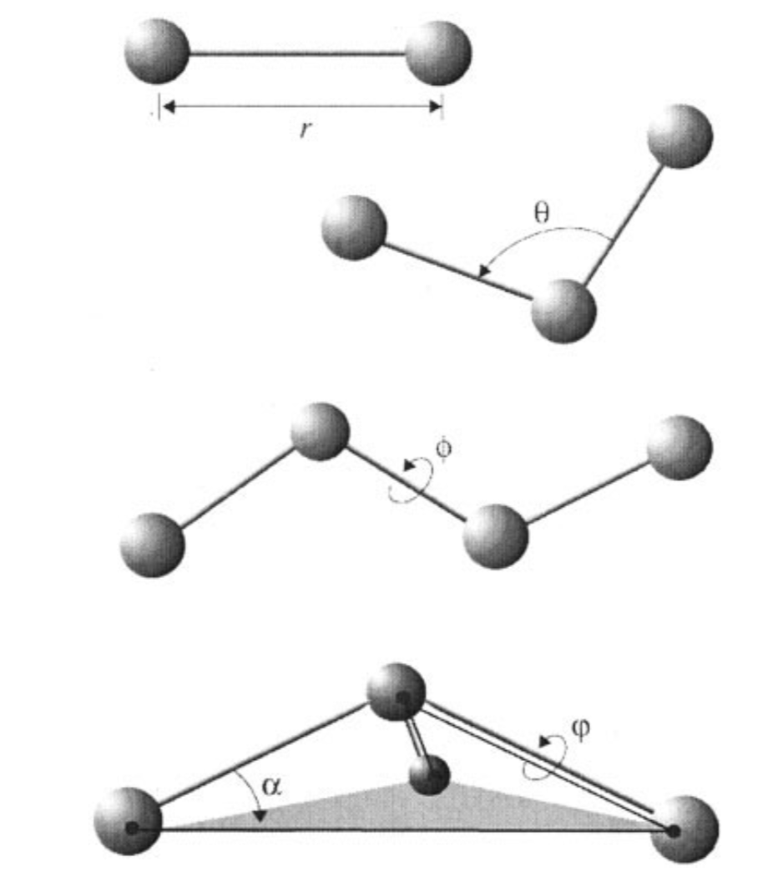
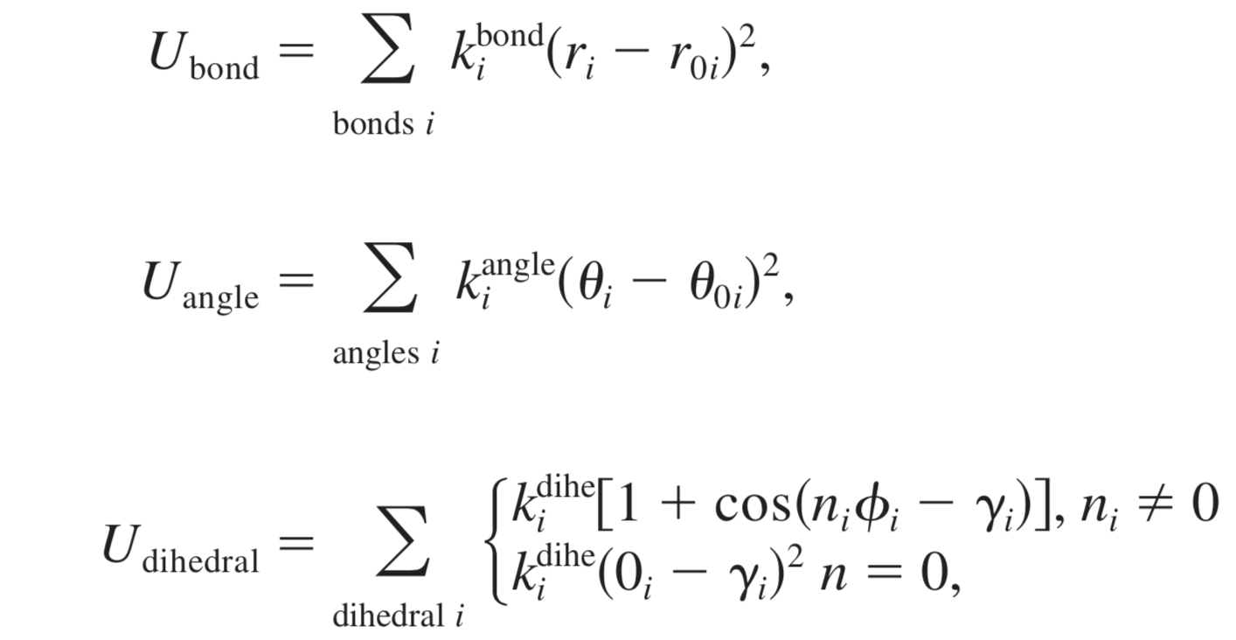
Force fields
Bonded interactions
Nonbond interactions
Phillips et al., J. Comp. Chem. 26, 1781--1802, 2005
neerajrai@che.msstate.edu

Slide 22
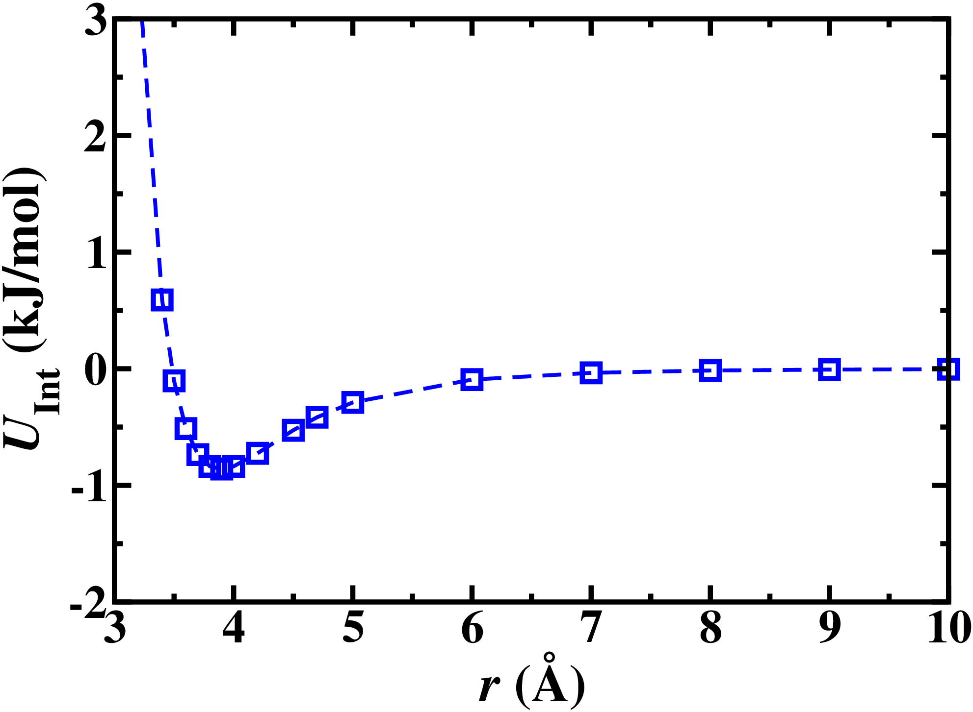
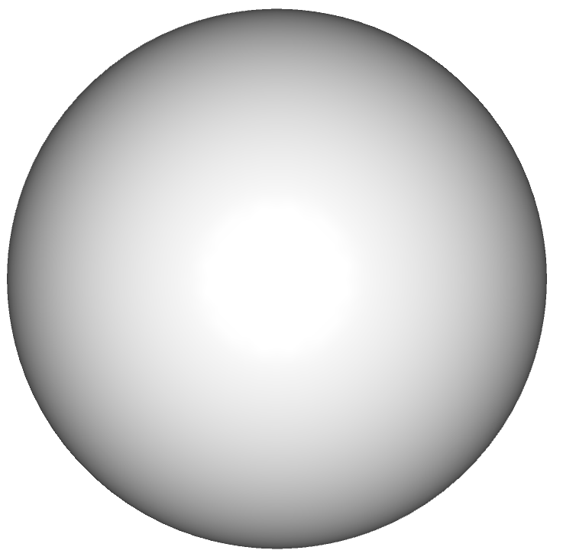
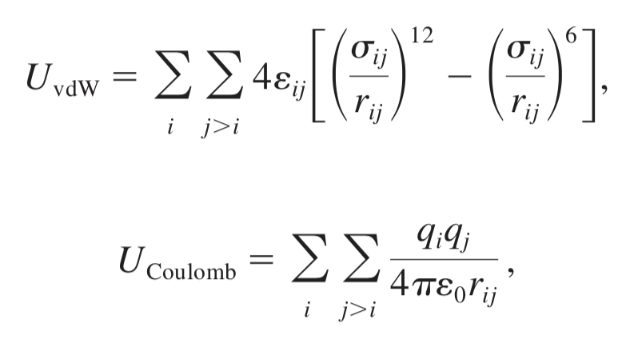
Force fields
Bonded interactions
Nonbond interactions
r
Phillips et al., J. Comp. Chem. 26, 1781--1802, 2005
neerajrai@che.msstate.edu

Slide 23
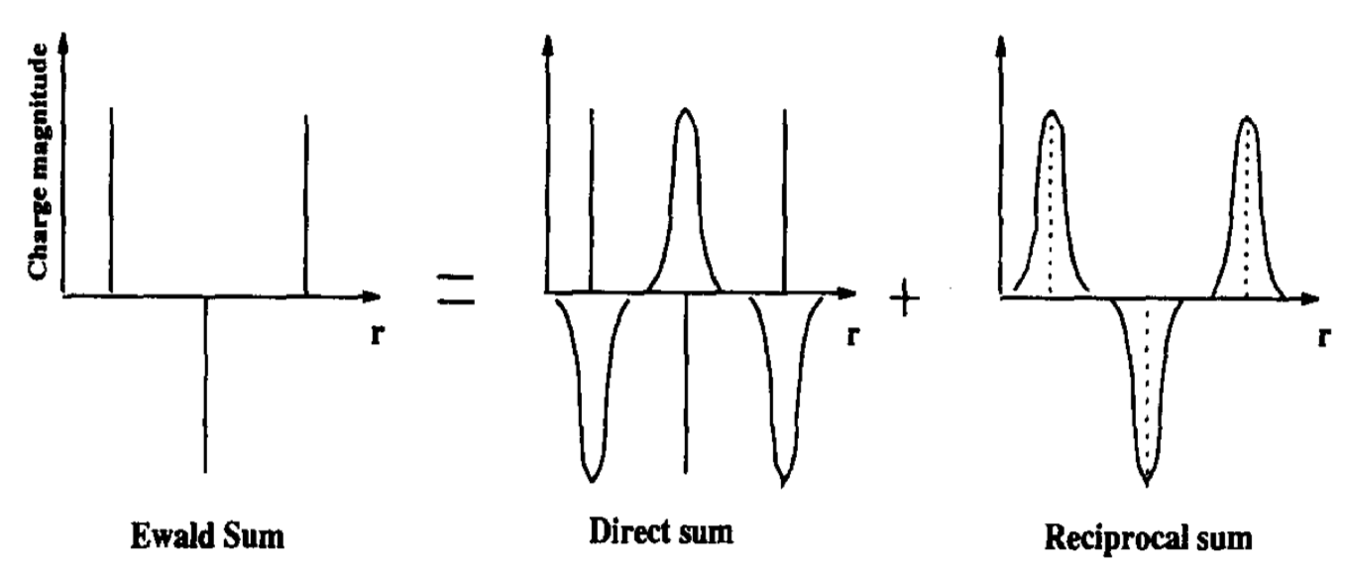
Computing electrostatic interactions
Toukmaji and Board Jr., Comput. Phys. Commun. 95, 73--92, 1996
neerajrai@che.msstate.edu

Slide 24
Molecular dynamics (MD)
Phillips et al., J. Comp. Chem. 26, 1781--1802, 2005
neerajrai@che.msstate.edu

Slide 25
Different ensembles
Microcanonical (NVE)
Canonical (NVT)
Grand canonical (μVT)
Isothermal isobaric (NPT)
Constant stress (NST)
Constant enthalpy (NPH)
neerajrai@che.msstate.edu

Slide 26
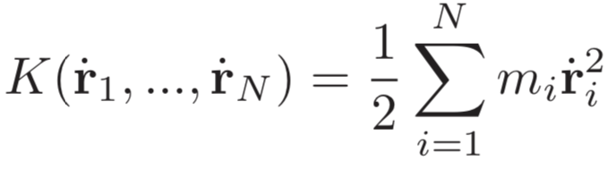
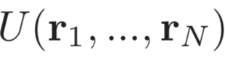
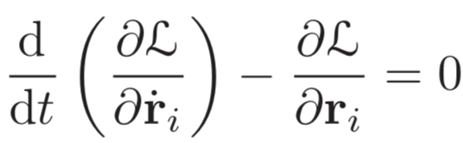
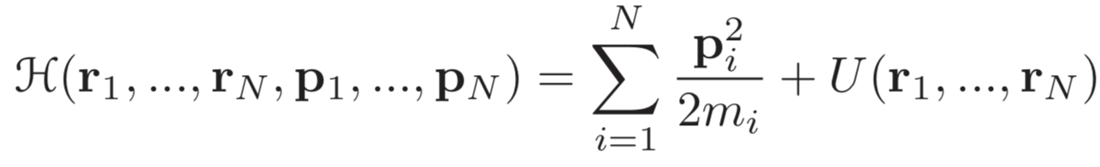
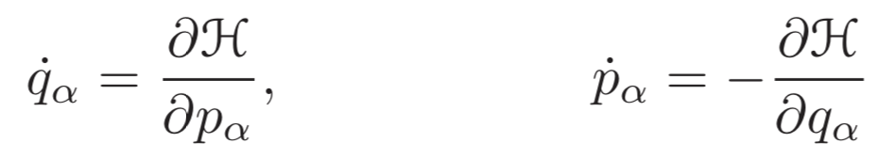
Lagrangian and Hamiltonian equations of motion (EOM)
Kinetic (K) and potential energy (U) of an N particle system is given by:
then the Lagrangian and Lagrangian EOM are:
and the Hamiltonian and Hamiltonian EOM are:
Statistical Mechanics: Theory and Molecular Simulation, Tuckerman
neerajrai@che.msstate.edu

Slide 27
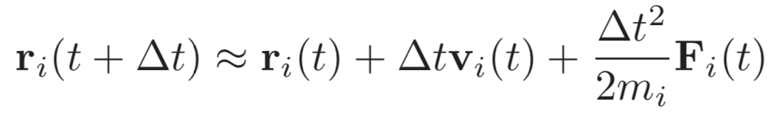
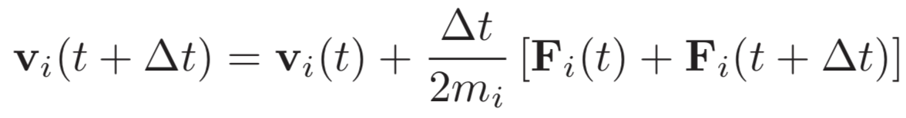
Integrating EOM: velocity Verlet
neerajrai@che.msstate.edu

Slide 28
Estimating Free energy landscape: Metadynamics
neerajrai@che.msstate.edu

Slide 29
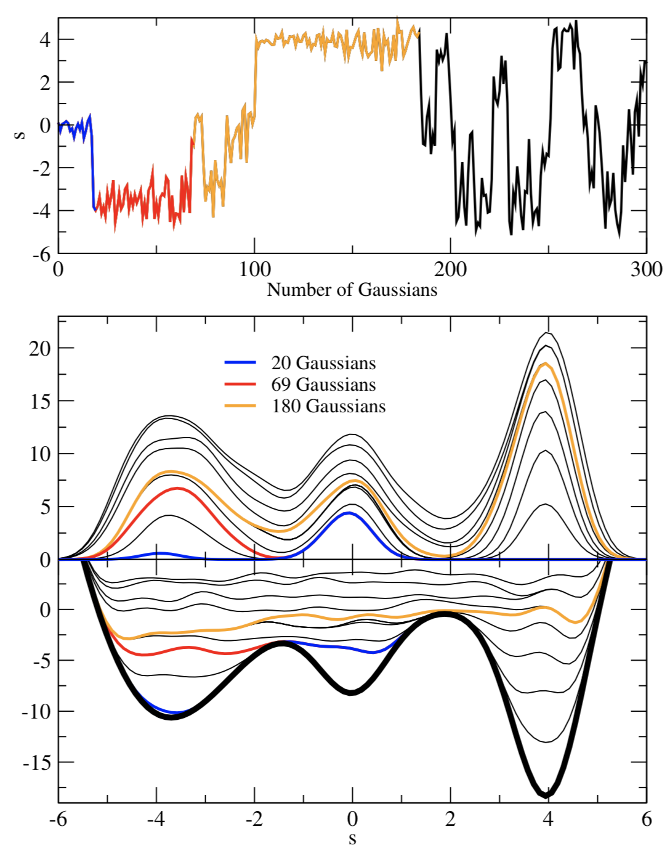
Metadynamics: the concept
Laio et al., Rep. Prog. Phys., 71, 12601 (2008)
neerajrai@che.msstate.edu

Slide 30
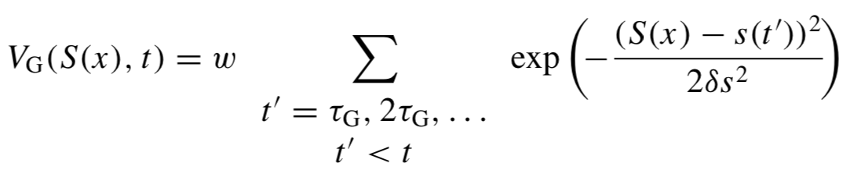
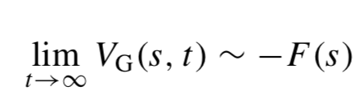
Metadynamics
The external potential added to the system at any given time:
S(x) is the collective variable. There are three parameters that governs the external potential:
1. Gaussian height (w)
2. Gaussian width (𝛿s)
3. Frequency (𝜏_{G}) at which Gaussians are added
The underlying free energy is given by:
Laio et al., Rep. Prog. Phys., 71, 12601 (2008)
neerajrai@che.msstate.edu

Slide 31
Different flavors of molecular dynamics
neerajrai@che.msstate.edu

Slide 32
The nomenclature
Type intermolecular Potential nuclear coordinate time evolution
MD analytic form (FF) classical (Newton’s EOM)
AIMD DFT/WFT classical
CPMD DFT classical, wave function (WFN) evolves along with nuclear coordinates
BOMD DFT/WFT classical, SCF cycle for the WFN at new nuclear coordinates
PIMD DFT/WFT/FF quantum
neerajrai@che.msstate.edu

Slide 33
Born-Oppenheimer Molecular Dynamics
neerajrai@che.msstate.edu

Slide 34
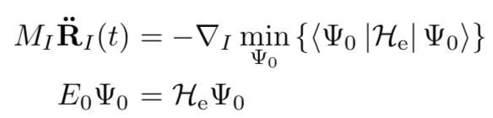
BOMD
The concept: solve the static electronic structure problem for each MD step
Ab initio Molecular Dynamics, Marx and Hutter
neerajrai@che.msstate.edu

Slide 35
Relevant sections in CP2K for molecular dynamics
neerajrai@che.msstate.edu

Slide 36
Questions?
neerajrai@che.msstate.edu

Slide 37
How to keep temperature constant in NVT ensemble?
Thermostats attempt to mimic the effect of coupling system to thermal reservoir or bath
neerajrai@che.msstate.edu

Slide 38
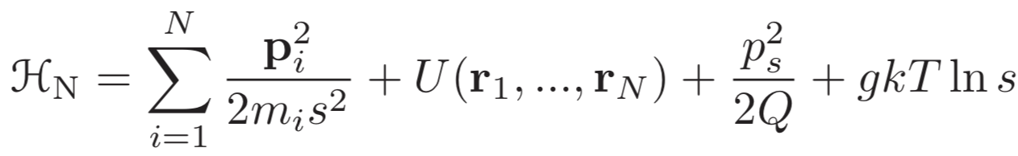
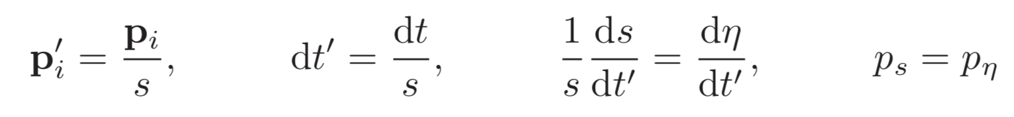
How to keep temperature constant in NVT ensemble?
Extended Hamiltonian approach due to Nosé introduces a new variable s that controls the temperature
Nosé-Hoover formulation is used extensively in molecular dynamics
Statistical Mechanics: Theory and Molecular Simulation, Tuckerman
neerajrai@che.msstate.edu

Slide 39
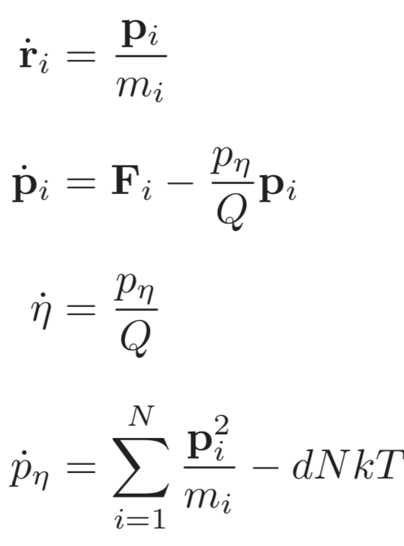
How to keep temperature constant in NVT ensemble?
Nosé-Hoover formulation is used extensively in molecular dynamics
New EOM are:
Statistical Mechanics: Theory and Molecular Simulation, Tuckerman
neerajrai@che.msstate.edu

Slide 40
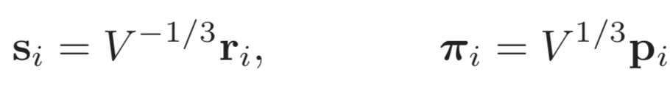
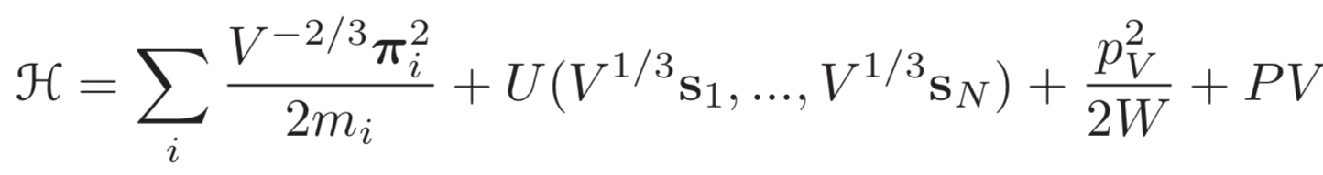
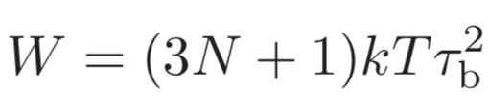
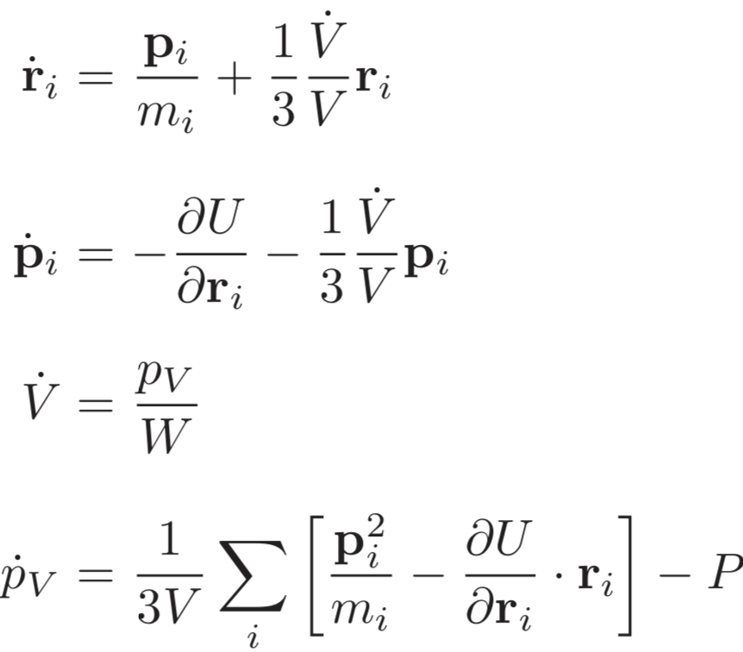
How to keep pressure constant in NPT ensemble?
We can use pressure bath (piston) to maintain and use scaled coordinates:
The Hamiltonian:
New EOM are:
;
Statistical Mechanics: Theory and Molecular Simulation, Tuckerman
neerajrai@che.msstate.edu

Slide 41
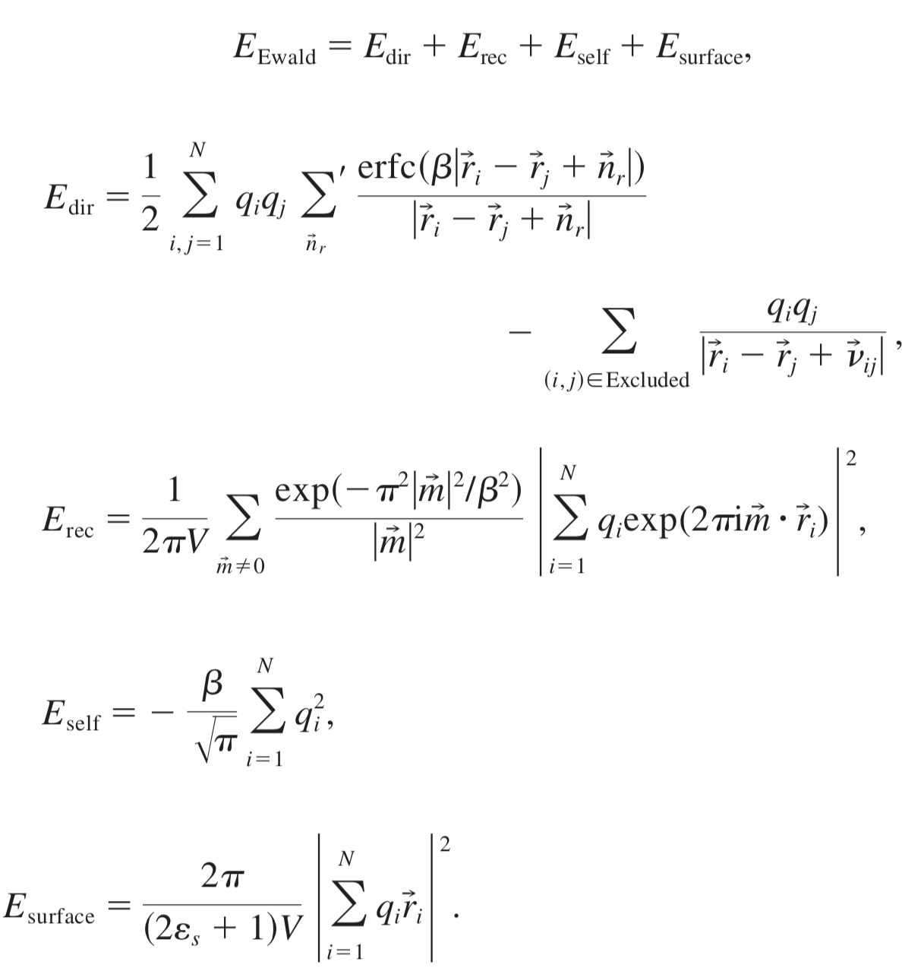
Computing electrostatic interactions
Phillips et al., J. Comp. Chem. 26, 1781--1802, 2005
neerajrai@che.msstate.edu

Slide 42
Questions?
neerajrai@che.msstate.edu

